Slide 1

Gender Classification
Gabrielle Beinars

Slide 2
Background & Problem Statement
Social Media & Communication
Benefits of Mining Text Data
Purposes
Notes:
Social media has become increasingly popular over recent years providing an abundance of unstructured data to be mined and analyzed. Using this data can allow for a better understanding of society and thus improving social interactions. Twitter is a popular and free social forum that allows members to create microblogs, referred to as “tweets”.^{[1]} The human mind is complex, and analysis of tweets can provide insight to various behavior patterns of individuals. Communication has changed vastly over the years due to the increase in technology, thus deeming it imperative to better the understanding of human interaction in modern times.
There are endless benefits to data mining and analyzing social media, specifically “tweets”. Making sense of common words can allow for improved marketing, understanding the relationship between users and various topics, and improved interaction in society. It is important to keep the focus of analysis on social media specific to epistemology, rather than exploitation and purposes of greed

Slide 3
Data
Kaggle - Eight, F. (2016, November 21). Twitter user gender classification. Kaggle. Retrieved September 19, 2021, from https://www.kaggle.com/crowdflower/twitter-user-gender-classification.
20,050 rows, 26 columns
Target variable - gender
Notes:
The data used for this project consists of unstructured data and was obtained from Kaggle.
The data was provided by Data for Everyone Library on CrowdFlower.
The gender variable contained 4 classes: male, female, unknown and brand.

Slide 4


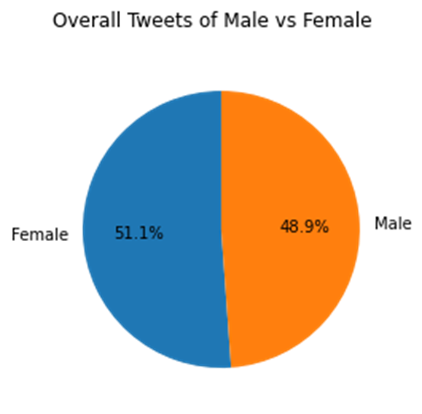
Exploratory Data Analysis – Data Preparation
Null values
Preprocessing
Male and Female, 0 and 1
Notes:
As the focus of this project is on content between male and female, observations that were unknown or brand were excluded
As tweets and profile description were the main focus of predicting gender for this project, all other features were removed from the dataset
Entire rows were dropped where there was a null value (empty) in tweets or profile description
The final dataset to be processed forward had a shape of 12,991 rows and 3 columns which was still a sufficient amount for modeling.
Preprocessing consisted of converting all tweets and profile descriptions to lowercase and removing any punctuation

Slide 5
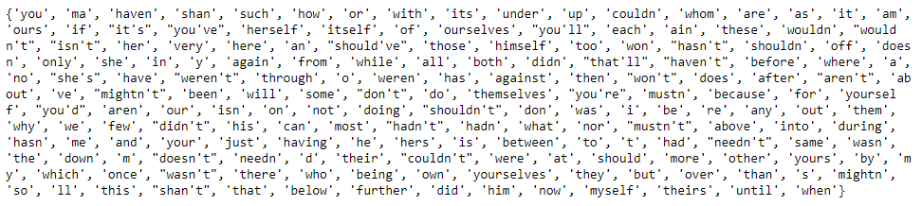
Stop Words, Stemming & Vectorizing
Notes:
Stop words were removed using the natural language processing toolkit library, also known as nltk
Here is a visual to display the stop words that were removed
Stop words are those that appear frequently but don’t provide any value to the analysis
Porter stemmer’s algorithm was used for word stemming, which is a process that removes part of the word, keeping just the base or root of the word.
This allows for words that carry the same value to be treated the same, for example, loves and lovely would both become love.

Slide 6
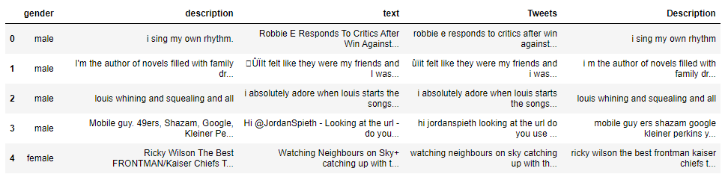
Preprocessing Before and After
Notes:
Here we can see a few examples of before and after preprocessing was completed. The second and third row, where we have description and text, show the text before preprocessing, and the last two columns here, Tweets and Description, show the results after preprocessing is complete.

Slide 7
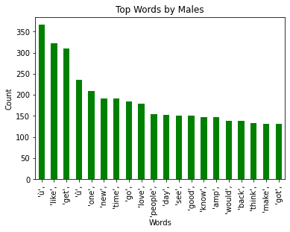
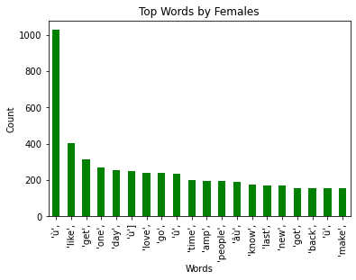
Top Words by Gender
Notes:
Here we see the top 20 words tweeted by male and by female. There are quite a few similarities, words that were unique to males top 20 words were “see”, “good”, “would”, and “think”. The only word unique to females was “last”.

Slide 8
Modeling Results
Model | Accuracy Using Tweets | Accuracy Using Profile Description
Naïve Bayes Gaussian | 57.3% | 63.5%
Naïve Bayes Multinomial | 57.2% | 64.3%
Logistic Regression | 55.6% | 64.6%
XGBoost | 67.8% | 63.5%

Slide 9
Assumptions
Binary Gender
Naïve Bayes Gaussian
Naïve Bayes Multinomial
Logistic Regression
XGBoost
Notes:
An assumption made through the entirety of this project is that gender is binary, however, some may argue this is not the case. This project should be updated in the future when more data is available on a third binary gender option.
With Naïve Bayes classification, the assumption is made that each feature is independent and equal, meaning that none of the features depend on another such that all are equally important and equally contributed to the outcome
The difference between Gaussian and multinomial, are that with multinomial feature vectors are represented as frequencies. Both models are commonly used successfully with text classification.
Logistic regression is a type of classification that is used to predict a binary target variable. Binary indicates two options, here it was male or female. The assumptions are little to no multicollinearity meaning there isn’t any correlation between the predictor variables and the response variable, all observations are independent, and that there are no major outliers
The last model explored was xgBoost, a machine learning algorithm that is an optimized distribution gradient boosting library
Boosting is known to improve the accuracy because when predictions are incorrect, they are weighted lower, with correct predictions weighing higher.

Slide 10
Challenges & Next Steps
Ethical considerations
Lack of non-binary gender data
Notes:
With any project that has a social focus, it is important to be aware of ethical considerations through the project. Many data science projects that exist, including this one, focus on a binary result of gender, male or female. However, this could be deemed an incorrect generalization in today’s culture as the assumption of only male and female reinforces the idea that gender is binary. There is a large lack of data on non-binary gender as it has not always been recognized as a third gender option. In fact, it wasn’t until 2020 that a third gender option was acknowledged legally. On a federal level within the US, in February of 2020, a legislation was introduced that would add the third classification option to US passport applicants, and this is expected to be implemented by the end of 2021
As a nonbinary gender option is a recent implementation in the US, in the future, I plan to further explore gender classification with the addition of a nonbinary category.

Slide 11
Questions from the Audience
What were some commonalities in tweet words between male and female?
What are the differences in tweet words between male and female? Are there words that are unique to gender?
What approach was used to preprocess the data?
How accurately can gender be predicted by using tweets?
Do females or males tend to tweet more?
Is their any acknowledgement for additional gender options?
Do the user profile descriptions or tweets predict gender better?
Could punctuation have played a strong role if it wasn’t cleaned out?
How were “slang” words, such as “u” for “you”, handled?
Is there any room for improvement?

Slide 12
References
[1] Contributor, T. T. (2015, December 25). What is twitter? - definition from whatis.com. WhatIs.com. Retrieved September 13, 2021, from https://whatis.techtarget.com/definition/Twitter.
[2] Felt, M. (n.d.). Social media and the social Sciences: How researchers employ big data Analytics - Mylynn Felt, 2016. SAGE Journals. Retrieved September 15, 2021, from https://journals.sagepub.com/doi/full/10.1177/2053951716645828.
[3] Eight, F. (2016, November 21). Twitter user gender classification. Kaggle. Retrieved September 19, 2021, from https://www.kaggle.com/crowdflower/twitter-user-gender-classification.
[4] rashida048. (2021, June 5). Exploratory Data Analysis of Text Data Including Visualization. Regenerative. Retrieved September 19, 2021, from https://regenerativetoday.com/exploratory-data-analysis-of-text-data-including-visualization-and-sentiment-analysis/.
[5] Bengfort, B., Bilbro, R., &amp; Ojeda, T. (2018). Applied text analysis with python: Enabling language-aware data products with machine learning. O'Reilly Media, Inc.
[6] Wikimedia Foundation. (2021, August 17). Legal recognition of non-binary gender. Wikipedia. Retrieved September 19, 2021, from https://en.wikipedia.org/wiki/Legal_recognition_of_non-binary_gender.
[7] Cummings, W. (2017, June 28). When asked their sex, some are going with option 'x'. USA Today. Retrieved September 19, 2021, from https://www.usatoday.com/story/news/2017/06/21/third-gender-option-non-binary/359260001/.
[8] Sayyadiharikandeh, M., Ciampaglia, G. L., & Flammini, A. (n.d.). Cross-domain Gender Detection in Twitter. Retrieved September 9, 2021, from https://glciampaglia.com/docs/papers/genderdetection_chasm.pdf
[9] Jain, P. (2021, June 1). Basics of countvectorizer. Medium. Retrieved September 23, 2021, from https://towardsdatascience.com/basics-of-countvectorizer-e26677900f9c.
[10] Naive Bayes classifiers. GeeksforGeeks. (2020, May 15). Retrieved September 23, 2021, from https://www.geeksforgeeks.org/naive-bayes-classifiers/.
[11] Kvijayan, V. (2019, September 23). Classification using logistic regression. Medium. Retrieved September 25, 2021, from https://medium.com/@vishnu0205/classification-using-logistic-regression-f14434d8545f.
[12] XGboost Python sklearn regression Classifier tutorial with code examples. DataCamp Community. (n.d.). Retrieved September 25, 2021, from https://www.datacamp.com/community/tutorials/xgboost-in-python.
[13] Tung.M.Phung. (2020, July 31). Assumptions of logistic regression. Tung M Phung's Blog. Retrieved September 25, 2021, from https://tungmphung.com/assumptions-of-logistic-regression/#:~:text=%20Assumptions%20of%20Logistic%20Regression%20%201%20Little,Logistic%20Regression%20is%20not%20famous%20for...%20More%20.

